Slide 1
WCA RECYCLING UPDATE FOR GREATER KANSAS CITY
Spring, 2020

Slide 2
WCA’s Footprint
Broad Footprint, Narrow Focus

Slide 3
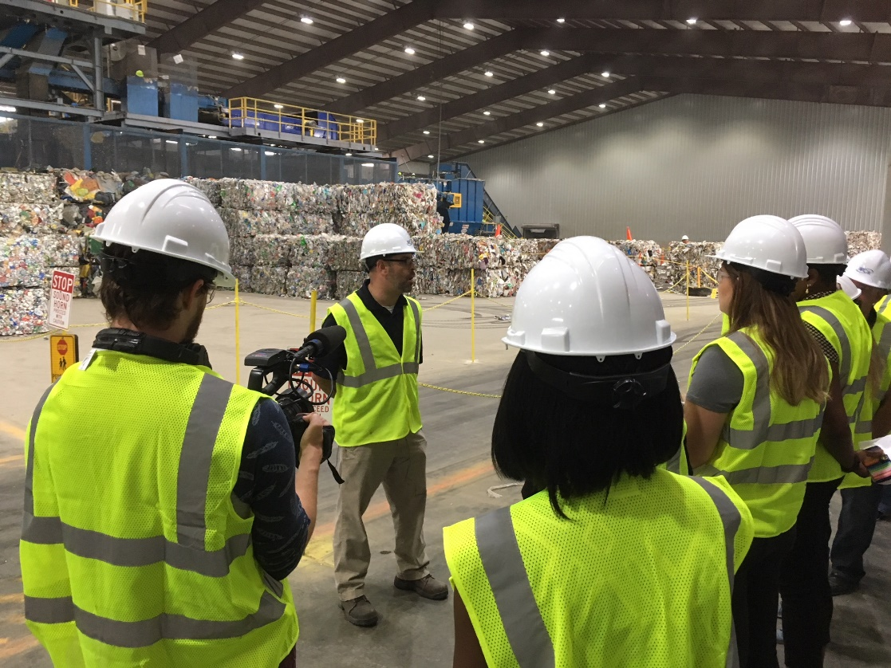
WCA’s Recycling Facility, Harrisonville MO
WCA’s $12 million Materials Recovery Facility, located in Harrisonville, is one of the largest in the region, processing more than 4,000 tons of material each month.

Slide 4
WCA MRF Facts
WCA’s Harrisonville MRF is one of the region’s two major single stream processing facilities
The facility has a processing capacity of approximately 80,000 tons per year
WCA processed approximately 50,000 tons of material in 2019
Improved sorting is required to create marketable material and remain financially viable
WCA plans 2020 investments in enhanced optical sorting and robotic sorting technology to reclaim more material and reduce contamination
WCA’s history of providing clean materials allows us to move materials when other processors scramble to find outlets

Slide 5
Snapshot of the 2019 Residential Stream

Slide 6
Curbside Commodity Details
More than two-thirds of the material we receive at our MRF is fiber (30% OCC, 37% mixed)
Paper prices are a leading driver of the MRF’s financial viability
Paper prices are at near-record lows
Contamination ranges from 18% to 25%
Contamination can cause shutdowns, make materials unmarketable and drive up processing costs
Plastics (nearly 8% of the stream) currently have solid markets and prices
Most contracts and solid waste ordinances mandate haulers collect all plastics #1 - #7, irrespective of values and outlets
Example: #6 Polystyrene foam containers have never been recyclable in single-stream residential programs

Slide 7
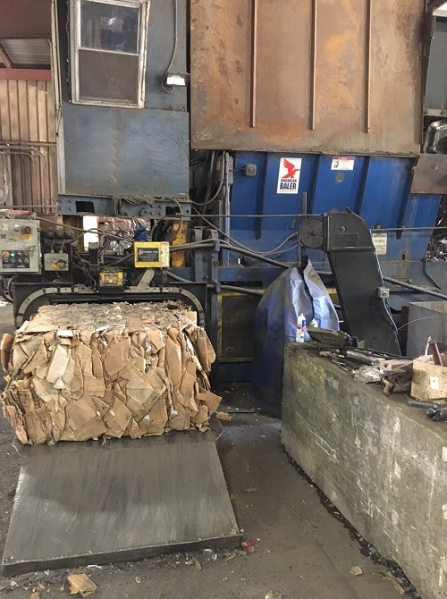
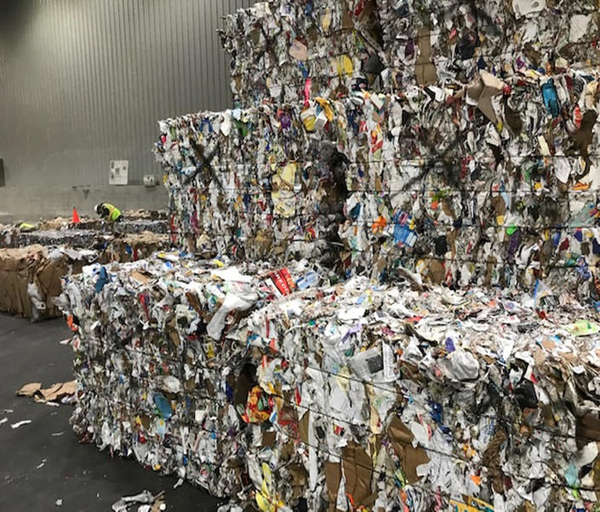
PAPER

Slide 8
Current Fiber Market Conditions
Mixed and News paper were early casualties of National Sword, eliminating China as the primary market
Domestic and other foreign mills did not have the capacity to absorb the orphaned materials
New mills are coming on line in Mexico and the US, and other mills are being retrofitted for Brown fiber production.
WCA has always been able to move fiber materials, but often at a cost
Most recently, WCA paid $17 per ton to have mixed paper hauled away (not including front-end costs)
Overall, pricing and movement continues to be a challenge while quality demands continue to be stringent.
WCA currently sorts two fiber grades – Cardboard ($43.60/t in January, 2020) and Mixed Paper ($0.20/t in January, 2020)
Mixed goes to a mill in Arkansas. When they are down we must long haul to Shreveport LA.

Slide 9
2019 Cardboard Pricing

Slide 10
2019 Mixed Paper Pricing

Slide 11
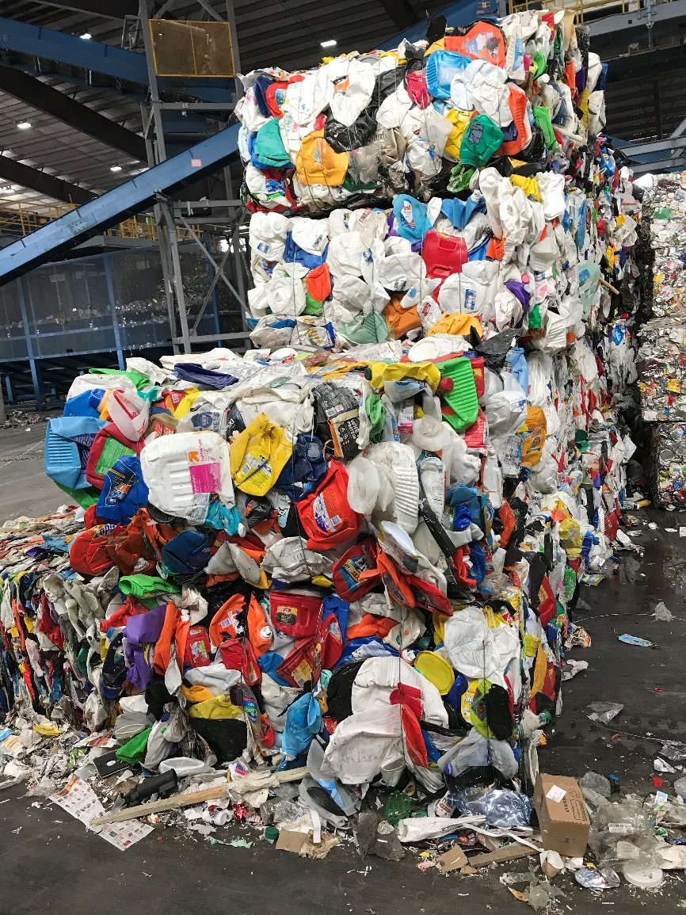
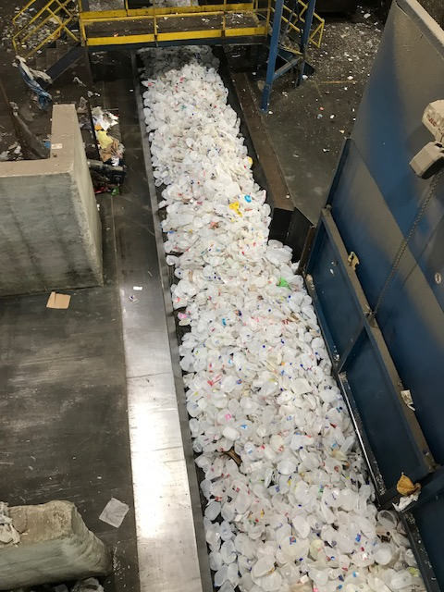
PLASTICS

Slide 12
Current Plastics Market Conditions
Following National Sword (2018), plastics moved to other Southeast Asian nations and Domestic markets. Domestic plastic markets have held up during the transition away from export markets.
Smaller nations have followed China’s lead; Malaysia returned 150 containers in January, 100 to follow soon. We no longer (since March 2019) ship any of our KC material export.
Studies show that most marine plastic pollution comes from developing Asian nations
US uses 37 million tons of plastics annually; 16 million tons are single-use (containers, bags)
Recovery (WTE, recycling) for US consumer plastics is about 28%; 90% in Japan & Germany
Nationally, 12 percent of plastics are recycled, 16 percent incinerated

Slide 13
Current Plastic Market Conditions cont’d
Demand for plastics continues to increase
WCA conducts four plastics sorts – PET #1, HDPE #2, Poly Propylene #5 and Mixed bulky Rigid (mix of mostly #2 and #5 plastics).
The most commercially viable/sustainable plastic resins are #1, #2 & #5. Seek out these resins to assure sustainability and recyclability.
Four plastic resins comprise 85% of single-use consumer plastics
#1 PET (soft-drink bottles, food trays) 25%
#2 HDPE (milk bottles, grocery bags) 25%
#4 LDPE (bread bags, container lids) 25%
#5 PP (yogurt containers, bottle caps) 10%
#3 PVC (blister packs, deli films) and #6 PS (foam cups, packing peanuts) not accepted as mixed plastics
Plastic bags, bagged recyclables, foam items are significant single-stream contaminants
Containers, containers, containers – specifically #s 1, 2 and 5

Slide 14
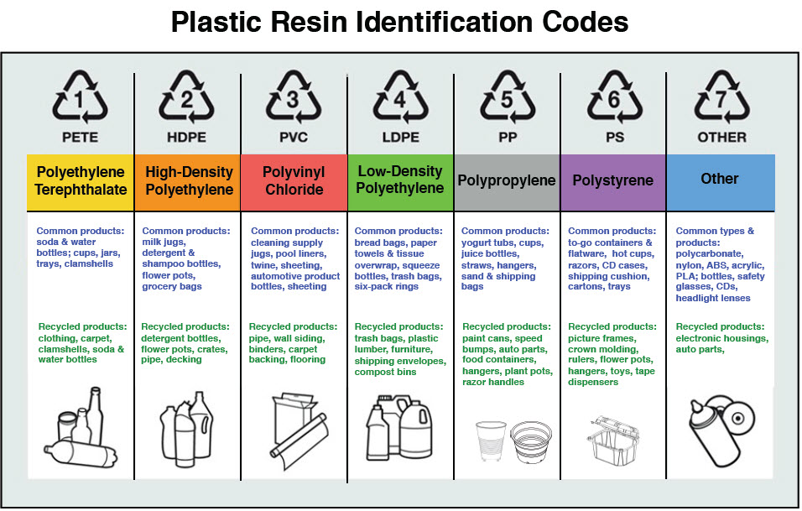
#1-7 Plastics Details, Examples

Slide 15
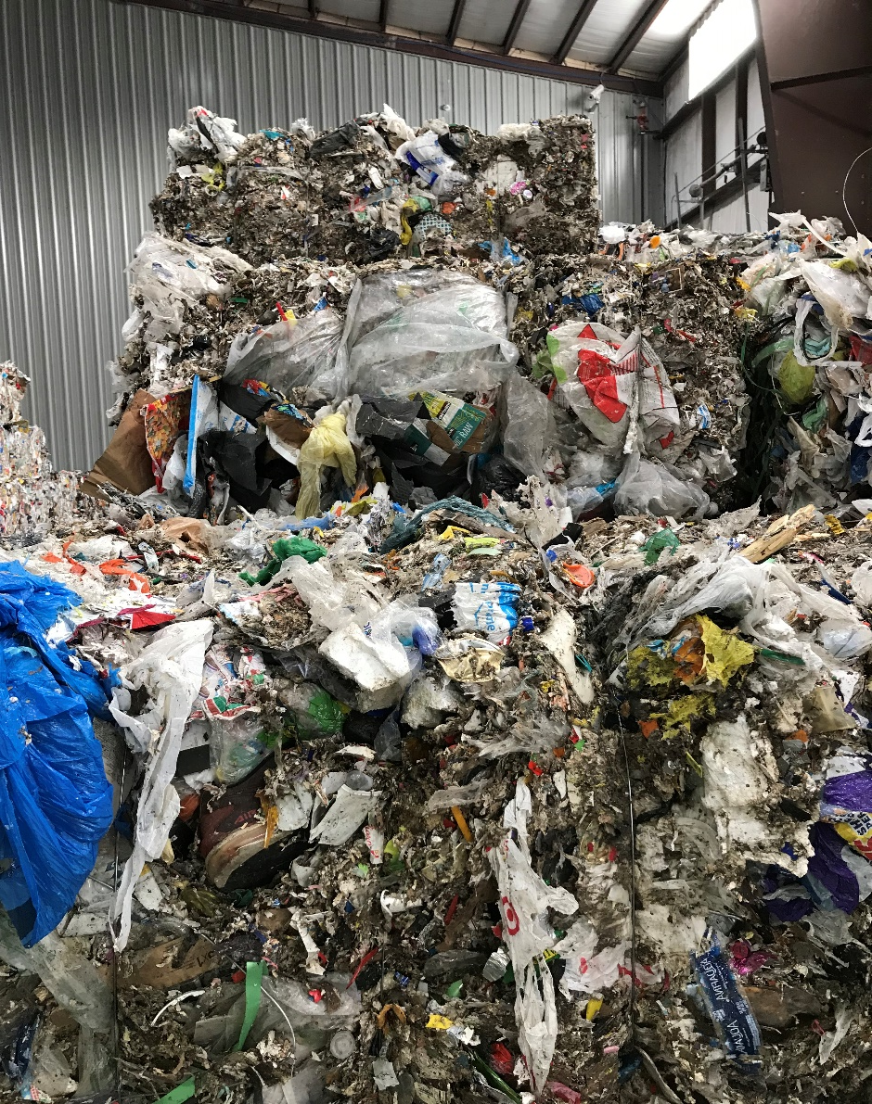
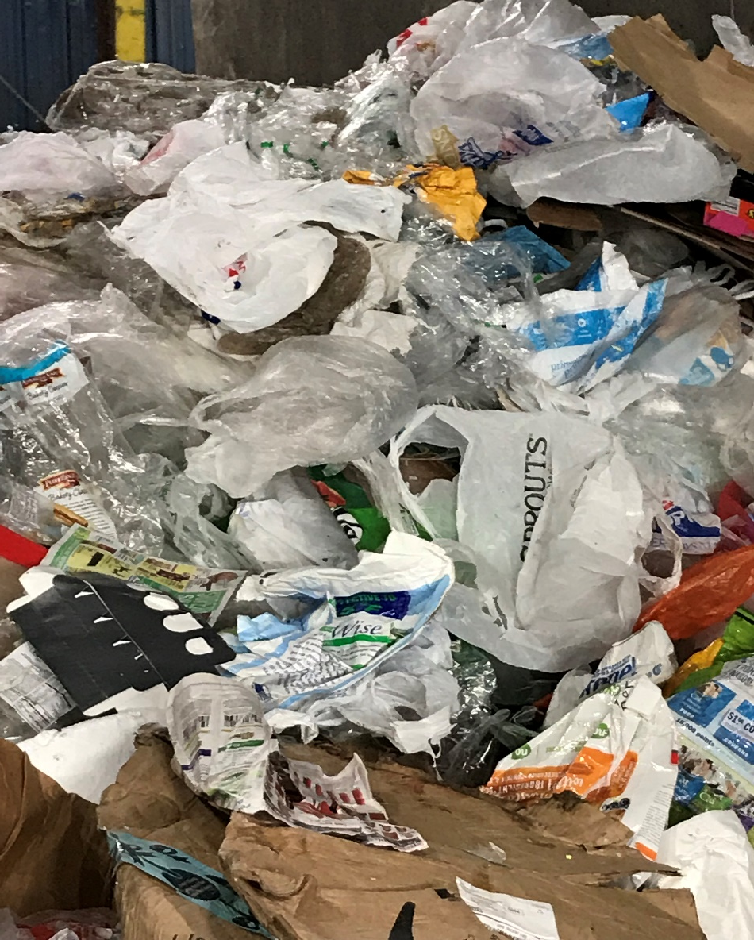
CONTAMINATION

Slide 16
Reducing Contamination Helps Control Costs, Protects Program Viability
WCA’s single-stream materials can include up to 25% trash
Contamination adds significant processing, transport & disposal costs
Single-use plastic bags remain a leading contaminant
Toys, clothes, food waste, soiled diapers, bowling balls, garden hoses and tarps are routine
Individuals continue to place their recyclables in plastic bags
Johnson County and MARC have undertaken curbside audits
Some communities and haulers now levy fines on residents for setting out contaminated recyclables
Communities across the country have reduced or eliminated residential recycling programs, particularly public drop offs.
REMEMBER: Real diversion rates do not measure tons set at the curb, but rather tons that are sorted, processed and marketed.

